Slide 1


REPORT OF
WEB DEVELOPMENT INTERNSHIP
at Thiranex • Skill Development & Future Tech
Submitted To
School of Computer Science and Engineering
IILM University, Greater Noida, U.P.
In partial fulfilment of the requirement for the degree of B.Tech CSE
Name: Sonu Kumar
Roll No.: 25SCS1003004915
Section: 2CSE5
Batch: 2025 – 2029
Email: sonu.25scs1003004915@iilm.edu
Academic Year: 2026-27

Slide 2
OVERVIEW
What This Presentation Covers
01
About Thiranex
02
Internship Timeline
The internship platform, its format and gamified Quest Log
Duration, onboarding, and task-by-task schedule
03
Objectives & Scope
04
Tech Stack
What the internship set out to teach and deliver
Languages, tools and concepts applied across all tasks
05
Five Completed Tasks
06
Architecture & Outcomes
Portfolio, responsive design, To-Do app, weather API, e-commerce capstone
How the projects were built, and what was achieved
07
Certificate of Completion
Verified proof of successful completion
Thiranex Web Development Internship | Sonu Kumar
2

Slide 3
ORGANIZATION PROFILE
About Thiranex
A project-based virtual internship platform that delivers structured, real-world web development experience through a gamified, task-driven intern dashboard.
Sequential “Quest Log” of tasks with fixed due dates
WEB DEVELOPMENT TRACK
Live progress tracker showing internship completion %
100%
Digital ID card, intern profile and downloadable offer letter
Internship Progress
WhatsApp community group for interns
Optional premium physical certificate, delivered to your doorstep
Tasks Completed
5 / 5
Verified digital certificate with QR-code authentication
Onboarding Task
Completed
Certificate
Issued & Verified
Thiranex Web Development Internship | Sonu Kumar
3

Slide 4
SCHEDULE
Internship Timeline
4 August 2026 → 3 September 2026
Immediate
18 Aug 2026
1 Sept 2026
Onboarding
Task 2
Task 4
Offer letter + LinkedIn post
Advanced CSS3 & Responsive Design
Async JS & RESTful APIs
Task 1
Task 3
Task 5
HTML5 Semantic & Accessibility
JavaScript Logic & State Mgmt
Capstone: Full-Stack Deployment
11 Aug 2026
25 Aug 2026
3 Sept 2026
All tasks marked “Completed Successfully” on the Thiranex dashboard.
Thiranex Web Development Internship | Sonu Kumar
4

Slide 5
GOALS
Project Objectives
1
2
3
Build accessible foundations
Design responsively
Engineer interactivity
Multi-page, semantic, WCAG-aligned HTML5 portfolio
Grid, Flexbox & theme-aware CSS3 across all devices
Stateful To-Do app with full CRUD and persistence
4
5
6
Integrate live data
Ship a capstone product
Practice real workflows
Consume a public REST API asynchronously via Fetch
Architect, optimize and deploy a live e-commerce app
Git/GitHub version control across every deliverable
Thiranex Web Development Internship | Sonu Kumar
5

Slide 6
TOOLKIT
Technologies & Tools Used
Languages
Core Concepts
Tools & Platforms
HTML5
Semantic Markup & ARIA
Visual Studio Code
CSS3
CSS Grid & Flexbox
Git & GitHub
JavaScript (ES6+)
DOM Manipulation
GitHub Pages
Async/Await & Fetch API
Lighthouse Audits
REST APIs & JSON
localStorage & CRUD
Thiranex Web Development Internship | Sonu Kumar
6

Slide 7
Key Features
Semantic tags: header, nav, main, section, footer
01
ARIA labels & roles for screen readers
SEO-optimized meta tags
TASK 1 • DUE 11 AUG 2026
Accessible, tab-navigable contact form
HTML5 Semantic Structure & Accessibility
EXPECTED OUTCOME
A fully accessible, semantic site scoring 100 on Lighthouse Accessibility & SEO.
Personal Portfolio Website
Live Deployment: sonu-crafts.github.io/sonu-dev
✓ Completed Successfully
Thiranex Web Development Internship | Sonu Kumar
7

Slide 8
Key Features
CSS Grid for 2D page layouts
02
Flexbox for component alignment
Mobile-first responsive media queries
TASK 2 • DUE 18 AUG 2026
CSS variables driving light/dark theme
Advanced CSS3 & Responsive Architecture
EXPECTED OUTCOME
A pixel-perfect, fully responsive site adapting across mobile, tablet & desktop.
Dark-Themed Developer Portfolio
Live Deployment: sonu-crafts.github.io/Sonu-dev-intern-2
✓ Completed Successfully
Thiranex Web Development Internship | Sonu Kumar
8

Slide 9
Key Features
Full CRUD functionality
03
Persistence via window.localStorage
Filtering: All / Active / Completed
TASK 3 • DUE 25 AUG 2026
Dynamic DOM + delegated event listeners
JavaScript Logic & State Management
EXPECTED OUTCOME
A state-driven task manager that retains data across browser reloads.
Orbit Tasks — 3D Task Manager
Live Deployment: sonu-crafts.github.io/internship-work-3
✓ Completed Successfully
Thiranex Web Development Internship | Sonu Kumar
9

Slide 10
Key Features
Fetch API with async/await
04
Robust network error handling
Parsing & rendering nested JSON
TASK 4 • DUE 1 SEPT 2026
City-based weather search
Asynchronous JavaScript & RESTful APIs
EXPECTED OUTCOME
A live dashboard showing accurate temperature, humidity & wind data.
AeroCast — Live Weather Dashboard
Live Deployment: sonu-crafts.github.io/Weather-forecasting
✓ Completed Successfully
Thiranex Web Development Internship | Sonu Kumar
10

Slide 11
Key Features
Modular front-end architecture
05
Client-side routing between views
Asset & performance optimization
TASK 5 • CAPSTONE
Live deployment to a public URL
Full-Stack Deployment & Project Architecture
EXPECTED OUTCOME
A production-ready web app, publicly deployed via GitHub Pages.
NOVA — Future Objects Storefront
Live Deployment: sonu-crafts.github.io/task5
✓ Completed Successfully
Thiranex Web Development Internship | Sonu Kumar
11

Slide 12
HOW IT WORKS
System Architecture
All five projects follow a client-side architecture: static HTML/CSS/JS served directly to the browser and deployed via GitHub Pages.
Browser
(Client)
Static Site
HTML / CSS / JS
localStorage
(Task 3)
Weather REST API
(Task 4, via Fetch)
GitHub Pages
(Deployment)
Task 3 persists state locally in the browser; Task 4 fetches live JSON asynchronously from a public REST API; Task 5 uses client-side routing and in-memory cart state — no custom backend was required for any task.
Thiranex Web Development Internship | Sonu Kumar
12

Slide 13
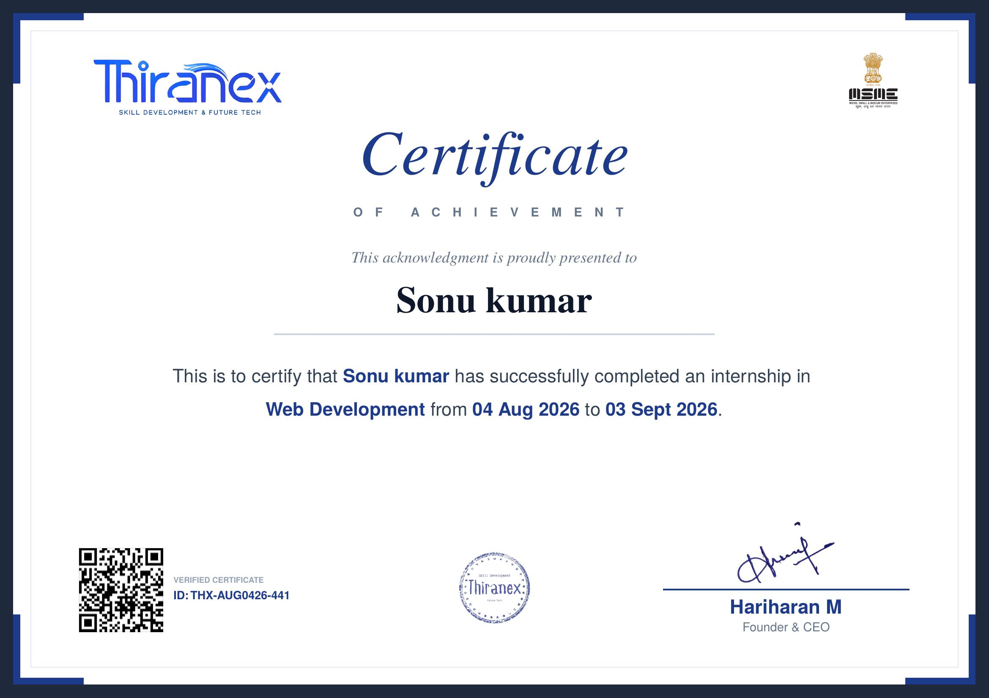
VERIFIED
Certificate of Completion
Certificate ID: THX-AUG0426-441 | Issued by Hariharan M, Founder & CEO, Thiranex
Thiranex Web Development Internship | Sonu Kumar
13

Slide 14
REFLECTION
Key Outcomes & Learnings
Technical Skills Gained
Professional Takeaways
Semantic, accessible HTML5 authoring
5 live, portfolio-ready projects with public URLs
Advanced responsive design with Grid & Flexbox
Real due-date-driven delivery, like an industry sprint
Stateful JavaScript apps with local persistence
Consistent Git/GitHub version control practice
Async API integration with error handling
A verified, shareable completion certificate
End-to-end deployment via GitHub Pages
Confidence to build & ship complete web apps solo
Thiranex Web Development Internship | Sonu Kumar
14

Slide 15
Thank You
Web Development Internship • Thiranex • 2026-27
Sonu Kumar
Roll No.: 25SCS1003004915 | Section: 2CSE5
sonu.25scs1003004915@iilm.edu

